Slide 1
Chapter 6: Homeostasis controls fluid and gas levels

Slide 2
6.1 Regulation of the composition of body fluids
Water makes up a large proportion of the human body. It is not pure water; rather, it contains dissolved substances. This fluid plays many important roles in the body, including transporting substances from one area of the body to another, facilitating movement across membranes and being the site of chemical reactions. Therefore, it is vital that the volume of water and concentration of dissolved substances is controlled to remain within the tolerance levels for the body.
Distribution of body fluids
The body of a male weighing 70 kg, with a water content of 60%, would contain 42L of water. This large amount of water is distributed between the various body fluids.

Slide 3
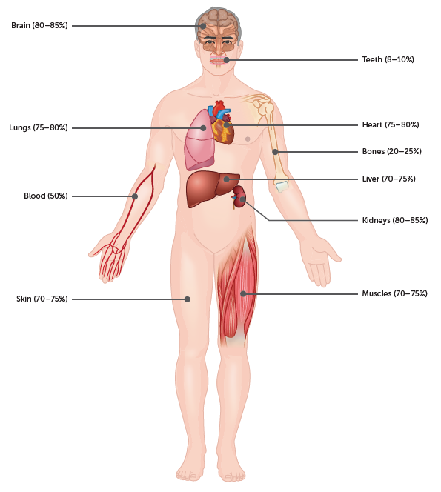
6.1 Regulation of the composition of body fluids
Water content of different body structures

Slide 4
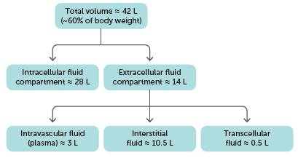
6.1 Regulation of the composition of body fluids
Fluid inside the cells is called intracellular fluid, or cytosol.
Fluid outside the cells is extracellular fluid. Extracellular fluid includes the:
– blood plasma located within the blood vessels, also known as intravascular fluid
– fluid between the cells, known as interstitial fluid, intercellular fluid or tissue fluid
– fluid in specific body regions, known as transcellular fluid, which includes the fluid in the brain and spinal cord, eyes and joints, and surrounding the heart.
Distribution of body fluid in an average male adult

Slide 5
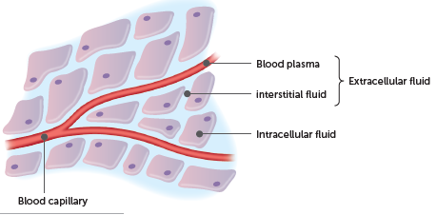
6.1 Regulation of the composition of body fluids
There is a continuous exchange of materials between the different body fluids. Plasma is separated from the interstitial fluid by the thin walls of the capillaries, and there is a relatively free exchange of materials between the two.
Water moves easily through plasma membranes, and so any difference in osmotic concentration between the intracellular fluid and the extracellular fluid does not last very long. If an imbalance in osmotic concentration does occur in any tissue, osmosis normally restores the balance within seconds.
The tendency of a solution to take in water is known as osmotic pressure. The greater the difference in osmotic concentrations between two solutions, the greater the osmotic pressure.

Slide 6
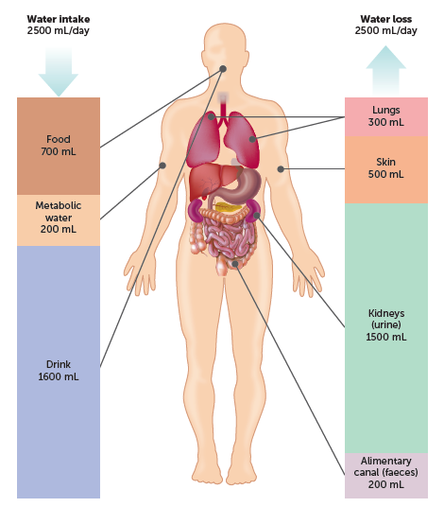
6.1 Regulation of the composition of body fluids
Maintaining fluid balance
Fluid gain must equal fluid loss if the composition of body fluids is to be kept fairly constant. Most body fluid is obtained from water that is either taken in as a liquid or contained in food that is eaten. A small amount is obtained as a by-product of chemical processes occurring within the cells. This water is referred to as metabolic water.
Fluids are lost from the body via the kidneys, through the skin, from the surface of the lungs and from the alimentary canal. Typically, about 2.5 L of fluid are lost each day.

Slide 7
6.1 Regulation of the composition of body fluids
Excretion
Excretion is the removal of the waste products of metabolism from the body. Many wastes are toxic and would be harmful to health if allowed to accumulate in the body fluids. Several organs in the body take part in excretion.
The lungs are involved in the excretion of carbon dioxide. Some water is also lost from the lungs, in the form of water vapour, as we exhale.
Sweat glands in the skin secrete water containing by-products of metabolism such as salts, urea and lactic acid.
The alimentary canal passes out bile pigments that entered the small intestine with the bile. These pigments are the breakdown products of haemoglobin from red blood cells. They leave the body with the faeces.
The kidneys are the principal excretory organs. They are responsible for maintaining a constant concentration of materials in the body fluids. One of the important wastes removed by the kidneys is urea, which is produced in the liver during the breakdown of proteins.

Slide 8
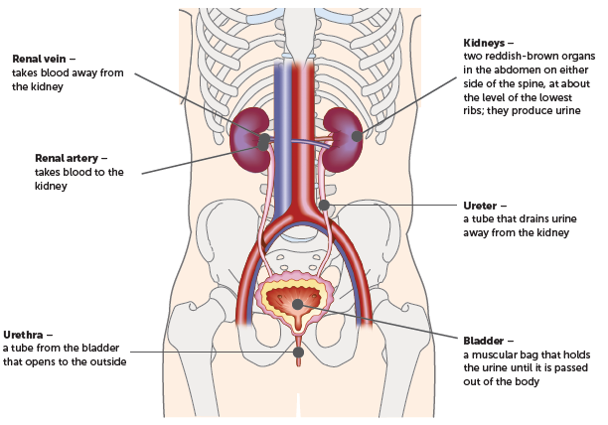
6.1 Regulation of the composition of body fluids
Kidneys
Only water loss from the kidneys can be regulated to achieve a constant concentration of dissolved substances in the body fluids. Therefore the kidneys play a major role in regulating the composition of body fluids.
Kidneys and associated organs

Slide 9
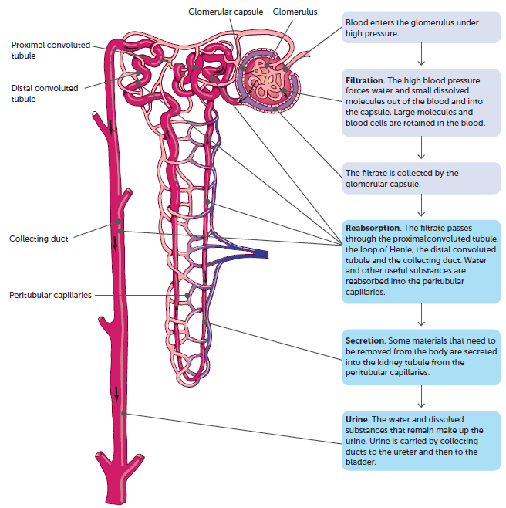
6.1 Regulation of the composition of body fluids
Each kidney contains about 1.2 million microscopic units called nephrons. The nephrons carry out the kidney’s role in excretion and water regulation.

Slide 10
6.1 Regulation of the composition of body fluids
Controlling water levels
Water is continually lost from the body in sweat, urine, faeces and exhaled breath. Normally, this is balanced by water intake. However, at times of strenuous activity or extreme heat this water loss can be quite high. As water is lost, the plasma becomes more concentrated and hence has a higher osmotic pressure. As a result, water moves from the interstitial fluid into the plasma by osmosis.
This makes the interstitial fluid more concentrated and, therefore, water diffuses out of the cells, so the cells start to shrink from dehydration. When this happens, osmoreceptors in the hypothalamus detect the increase in osmotic pressure. A number of responses are then triggered that increase the water content and, hence, lower the osmotic pressure.

Slide 11
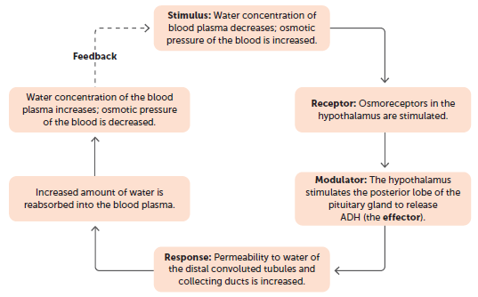
6.1 Regulation of the composition of body fluids
The kidneys and antidiuretic hormone
Approximately 99% of the water filtered through the glomeruli of the kidneys is reabsorbed. This reabsorption occurs through the walls of the kidney tubules along their entire length. The reabsorption occurring at the proximal convoluted tubule and loop of Henle is by osmosis, while reabsorption at the distal convoluted tubule and collecting tubule is active reabsorption. The level of active reabsorption is controlled by a hormone known as antidiuretic hormone (ADH).
The action of ADH in controlling water balance is another example of a feedback process maintaining the internal environment of the body.

Slide 12
6.1 Regulation of the composition of body fluids
The kidneys and aldosterone
Aldosterone, sometimes called the salt-retaining hormone, is secreted by the adrenal cortex in response to a:
decrease in the concentration of sodium ions in the blood
decrease in blood volume
decrease in blood pressure
increase in the concentration of potassium ions in the blood.
Aldosterone acts on the distal convoluted tubules and collecting ducts to increase the amount of sodium ions reabsorbed into the bloodstream and the amount of potassium secreted in the urine. It achieves this through active transport using a sodium-potassium pump, and therefore has a role in regulating water content of the body.

Slide 13
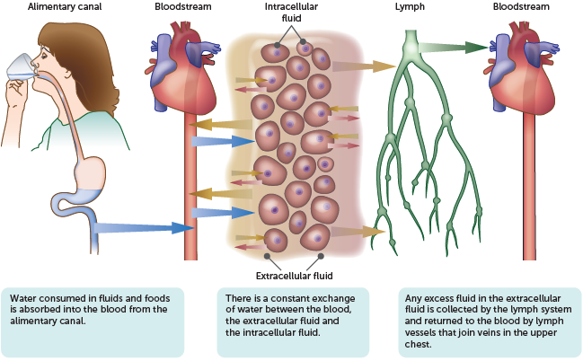
6.1 Regulation of the composition of body fluids
The thirst response
In addition to reducing water loss, the water level of the body can be increased by taking in more fluid. Osmoreceptors stimulate the thirst centre in the hypothalamus, prompting the person to drink water. This fluid is absorbed across the wall of the alimentary canal into the blood, decreasing the osmotic pressure.
Movement of water between the various parts of the body

Slide 14
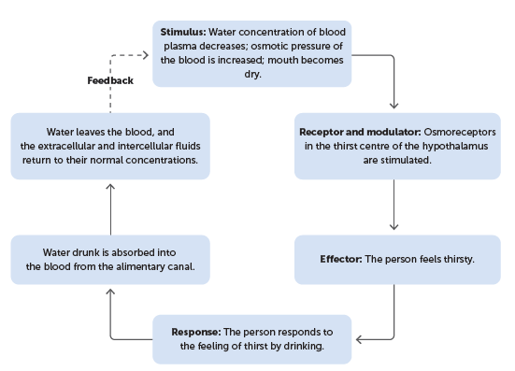
6.1 Regulation of the composition of body fluids
Regulation of water balance by the thirst mechanism

Slide 15
6.1 Regulation of the composition of body fluids
Too much and too little water
Dehydration is when water loss exceeds water intake and there is not enough water in the body for it to carry out normal functions. Symptoms of dehydration (severe thirst, low blood pressure, dizziness and headache) become noticeable when a person has lost about 2% of their normal body water. The loss may be through sweating, vomiting or diarrhoea.
Too much water in the body can cause water intoxication, or sometimes water poisoning. It occurs when body fluids become diluted and cells take in extra water by osmosis. This may happen if a person loses a lot of water and salts through sweating and replaces the loss with plain water. In such cases, the water consumed should contain dissolved substances to replace the lost salts as well as the water. The first sign of water intoxication is usually lightheadedness. Headache, vomiting and collapse may follow.

Slide 16

6.2 Regulation of gas concentrations
Cellular respiration occurs in cells to provide energy for its functions. As it uses oxygen and produces carbon dioxide, cells need a continuous supply of oxygen and removal of carbon dioxide. Therefore, it is crucial that the levels of these gases in the body are regulated.
The respiratory system is responsible for taking in oxygen and excreting carbon dioxide from the body. In particular, the lungs are the organs in which the exchange of carbon dioxide for oxygen occurs. Therefore, changes in breathing change the amount of oxygen taken in and the amount of carbon dioxide excreted.
The circulatory system carries oxygen from the lungs to the cells, where it is used. It also takes away the carbon dioxide produced and delivers it to the lungs for excretion from the body. Thus, the circulatory system is also involved in the regulation of gas concentrations.

Slide 17
6.2 Regulation of gas concentrations
Control of breathing
The muscles that cause air to move in and out of the lungs are:
the diaphragm, a muscle that separates the thorax from the abdomen
the intercostal muscles, the muscles between the ribs.
These are skeletal muscles and require stimulation from nerve impulses to initiate contraction. The diaphragm is stimulated by impulses from the phrenic nerve, while impulses from the intercostal nerves stimulate the intercostal muscles. These spinal nerves have their origin in the spinal cord at the level of the neck and thorax.
The nerve impulses that travel to the diaphragm and intercostal muscles are controlled by a respiratory centre located in the medulla oblongata of the brain. There are two regions within the respiratory centre: one that controls expiration and one that controls inspiration. To coordinate breathing, messages pass back and forth between the neurons in these two regions.

Slide 18
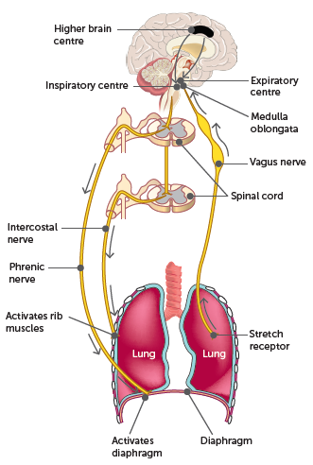
6.2 Regulation of gas concentrations
Control of breathing by respiratory centres in the brain

Slide 19
6.2 Regulation of gas concentrations
Chemicals affecting breathing
Oxygen, carbon dioxide and hydrogen ions all have some effect on the regulation of breathing activity.
Chemoreceptors
There are two types of chemoreceptors:
Peripheral chemoreceptors are groups of cells within the walls of the aorta and carotid arteries that are sensitive to changes in the concentration of oxygen, carbon dioxide and hydrogen ions in the blood plasma. These are known as the aortic and carotid bodies.
Central chemoreceptors are located in the medulla oblongata. These are sensitive to changes in the concentration of carbon dioxide in the blood and hydrogen ions in the cerebrospinal fluid.
When chemoreceptors are stimulated, they send a nerve impulse to the area of the respiratory centre that regulates breathing.

Slide 20
6.2 Regulation of gas concentrations
Oxygen concentration
As oxygen is consumed by the cells, its concentration in the blood begins to fall. If the concentration of oxygen falls below normal while other factors are held constant, the breathing rate increases. The concentration has to fall to very low levels before it has a major stimulatory effect. Under normal circumstances, oxygen plays little part in the regulation of breathing.
A large decrease in oxygen concentration stimulates the peripheral chemoreceptors, and nerve impulses are transmitted to the respiratory centre. These nerve impulses stimulate the transmission of messages to the diaphragm and intercostal muscles, and so the breathing rate and depth increases.

Slide 21
6.2 Regulation of gas concentrations
Carbon dioxide concentration
The concentration of carbon dioxide in the blood plasma is a major factor in the regulation of breathing rate. A relatively small increase in the concentration of carbon dioxide is enough to cause a marked increase in the rate and depth of breathing.
Any increase in carbon dioxide results in an associated increase in hydrogen ion concentration. The increase in concentration of both these chemicals in the blood stimulates the central and peripheral chemoreceptors. These in turn transmit nerve impulses to the respiratory centre, resulting in an increase in breathing rate and depth.
The chemoreceptors most sensitive to changes in the concentration of carbon dioxide in the plasma are those located in the medulla oblongata.
The immediate increase in breathing rate that occurs following an increase in the carbon dioxide concentration of the plasma is produced by the stimulation of the aortic and carotid bodies. These bodies are stimulated by the associated increase in hydrogen ion concentration.

Slide 22
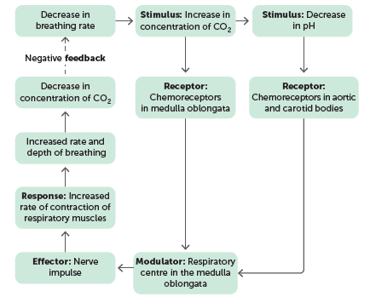
6.2 Regulation of gas concentrations
Hydrogen ion concentration
As the hydrogen ion concentration of the blood increases, the pH decreases. A decrease in the pH directly stimulates chemoreceptors in the aortic and carotid bodies, which then transmit impulses to the respiratory centre, resulting in an increase in the breathing rate and depth.
Negative feedback control of breathing rate through changes in the concentration of carbon dioxide and the pH of the blood plasma

Slide 23
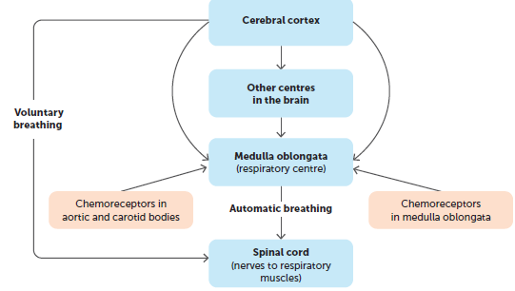
6.2 Regulation of gas concentrations
Voluntary control of breathing
Voluntary control of breathing comes via connections from the cerebral cortex to descending tracts in the spinal cord, and therefore bypasses the respiratory centre in the medulla oblongata.
Holding our breath
We can hold our breath for a short time. The build-up of carbon dioxide in the plasma stimulates the inspiratory centre to send impulses to the inspiratory muscles. Therefore, we are eventually forced to take a breath.
Voluntary and involuntary control of breathing by the CNS

Slide 24
6.2 Regulation of gas concentrations
Hyperventilation
Rapid, deep breathing can provide more oxygen than required and remove more carbon dioxide than necessary. This is called hyperventilation. It can occur voluntarily or may be stimulated by physical stress such as severe pain or emotional stress such as extreme anxiety. Hyperventilation usually corrects itself because the reduction in carbon dioxide concentration means that the chemoreceptors are not stimulated, reducing the rate and depth of breathing until carbon dioxide levels return to normal.
Exercise and breathing
During exercise, the contracting muscle cells require large amounts of oxygen and produce large amounts of carbon dioxide. In responding to this increased demand for gas exchange, the respiratory system increases both the rate and depth of breathing.
During heavy exercise, the volume of air going into and out of the lungs each minute may increase 10- to 20-fold.

